Slide 1
Direct Volume Rendering

Slide 2
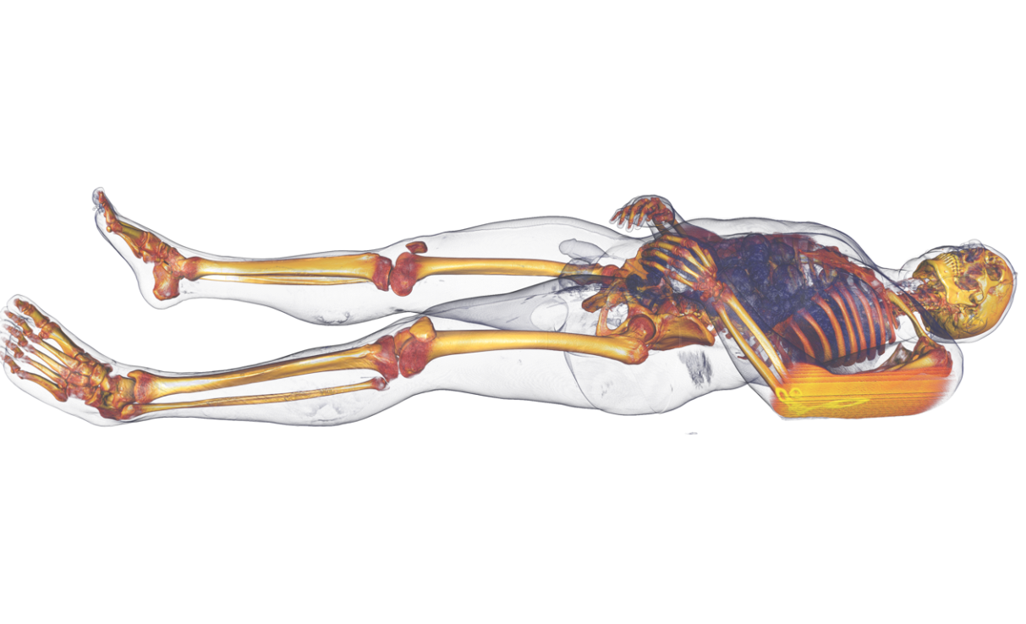
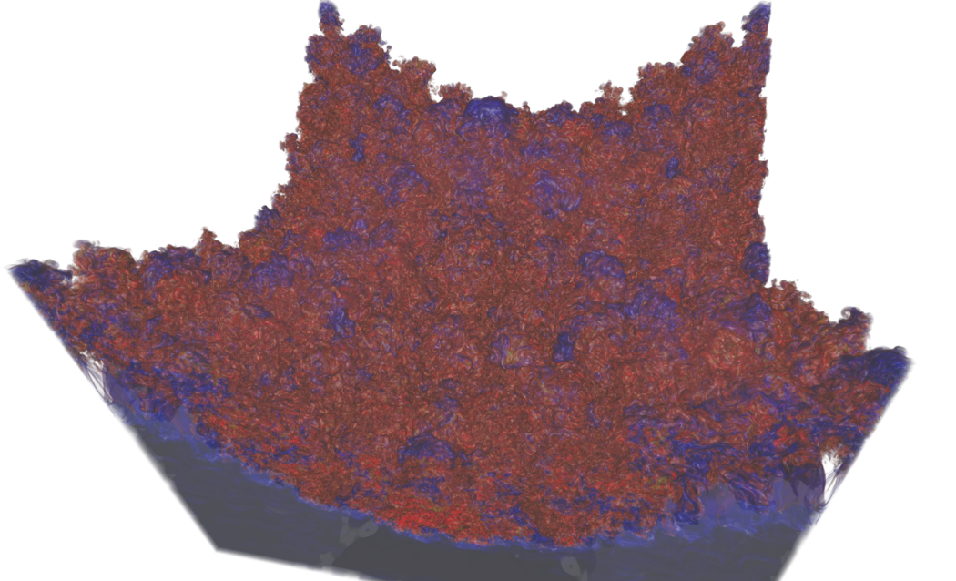
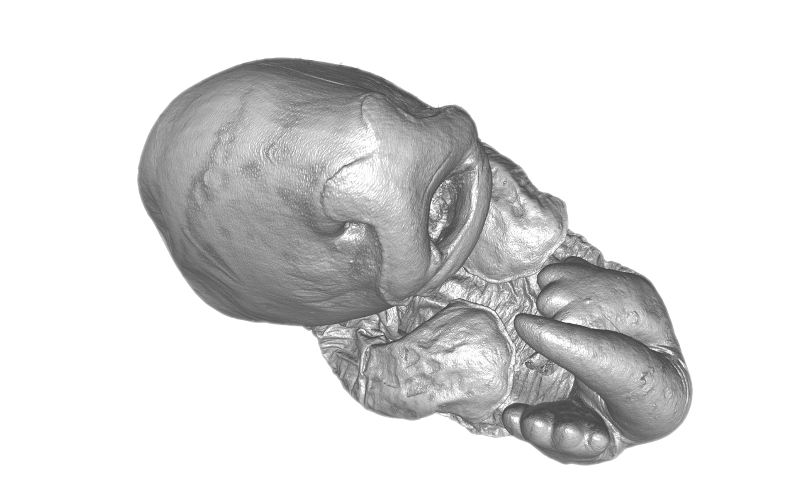
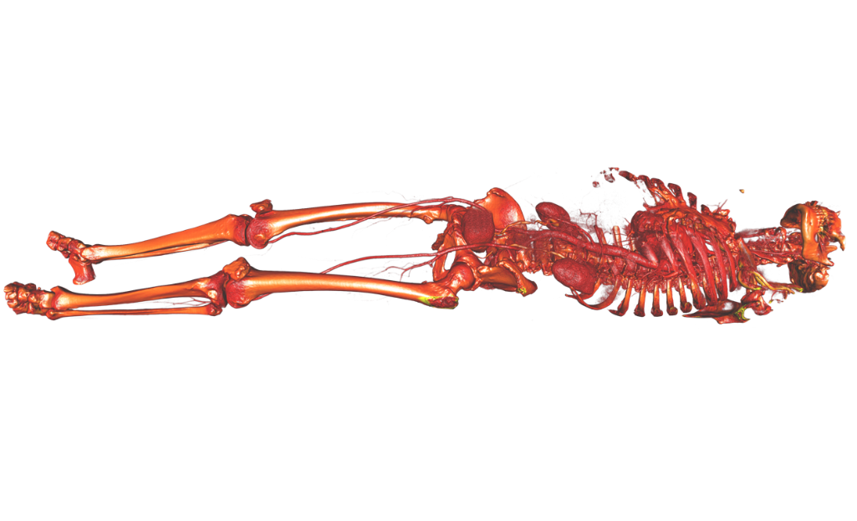

Slide 3
3D Volume Rendering
Direct VR
Slicing
Indirect VR
Ray-Casting
Slicing
Marching
Other
CPU
GPU
Ray-Guided GPU
View Aligned
Object/Axis Aligned
Cubes
Tetrahedra
Dividing Cubes
Contour Tracing

Slide 4
Strategies for Volume Visualization
Slicing
Visualize 2D cuts through the volume
Direct volume rendering
Consider the data as a light-emitting medium with specific emission and absorption properties. The visual impression when looking at it is simulated according to the laws of physics
Indirect volume rendering techniques
Convert/reduce volume data to an intermediate representation (e.g., surface representation), which can be rendered with traditional techniques
4

Slide 5
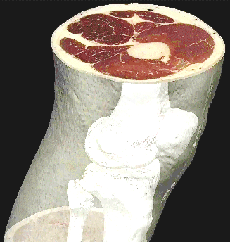
Hybrid Strategies
All three strategies can be combined:
Slicing: Map data to colors, display on a slice plane
Isosurfacing: (Semi-)opaque surfaces, material boundaries
Transparency effects: Volume material attenuates reflected or emitted light
Slice
Semi-transparent material
Isosurface
5

Slide 6
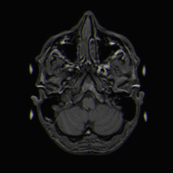
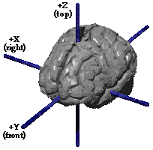
Slicing
Map data on a series of 2D planes through the volume
In medicine, this is still the most frequently used visualization
If data was acquired as a series of 2D slices, natural to show those
Other axis-aligned views
Rotate (“re-angulate”) to an object/patient-aligned view
Involves interpolation
Image Sources: Wikipedia, Graham Wideman
6

Slide 7

Transfer Functions
A transfer function maps data values to colors that can be used to visually display the data:
In most implementations, the color type C is a (red, green, blue) triple of either floating-point [0,1] or unsigned char [0,255] values.
When to apply?
Pre-classification applies T to the sampled data values and interpolates colors
Post-classification interpolates the data and applies T to the resulting value
7

Slide 8
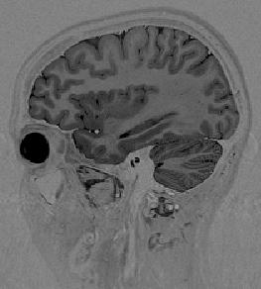
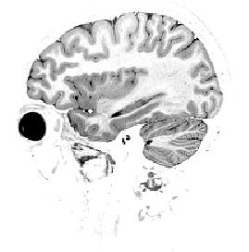
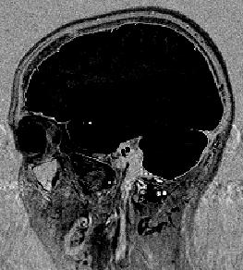
Windowing
One of the simplest transfer functions maps a range of data values (“window”) to a linear ramp of grayscales. Values outside that range are mapped to black or white, respectively.
Full Data Range
Brain Window
Tissue Window
8

Slide 9
Window Specification
Windows are commonly defined by their center c and width w≥1.
For data value x and color output range C∈[0,1], the following pseudo-code applies:
if (x <= c – 0.5 - (w-1)/2) then C := 0
else if (x > c – 0.5 + (w-1)/2) then C := 1
else C := (x - (c – 0.5)) / (w-1) + 0.5
w
c
data value
9

Slide 10
Histograms Can Guide Windowing
Histogram of all data values in a volume dataset:
%
histogram
data value
%
constituent’s distributions
tissue
air
fat
bone
data value
Fat / tissue window
10

Slide 11
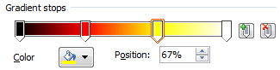
Color Maps
Transfer functions can also be used to map scalar data to color
Can be implemented as a color lookup table:
Often specified by defining the color for a discrete set of data values (“gradient stops”) and interpolating in between (e.g., in RGB):
R_{i}G_{i}B_{i}A_{i}
0
255
Scalar ∈(0,1)
Index
(0,1) → (0,N-1)
11

Slide 12
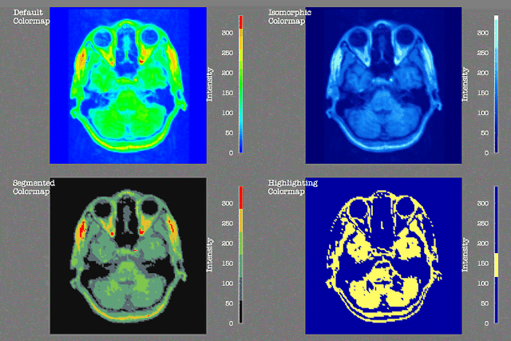
Impact of Color Maps on Interpretation
All these examples show exactly the same data:
Image Source:
Rogowitz et al.

Slide 13
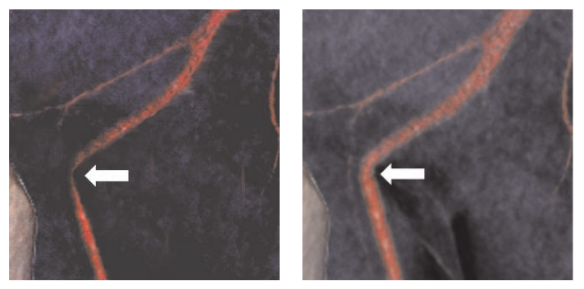
Pick Your Colors Wisely!
In this case, unnecessary surgery was performed based on a poorly adjusted color map:
Image Source: Lundström et al.
13

Slide 14
Some Classic Color Maps
Gray scale color table
Intuitive ordering
Rainbow color table
Based on HSV color space
“Black body radiation”
Cool-to-warm
Blue-to-yellow
14

Slide 15
Choosing Color Maps for Visualization
Some General Rules:
Stick to conventions
Temperature: warm=red, cool=blue
fMRI: activation=red, deactivation=blue
“Natural” appearance (bone=white, muscle=red)
When in doubt, interactively changing the transfer function can increase confidence
5-10% of the male population suffer from (partial) color blindness
Red-green weakness most common type
Women much less affected
15

Slide 16
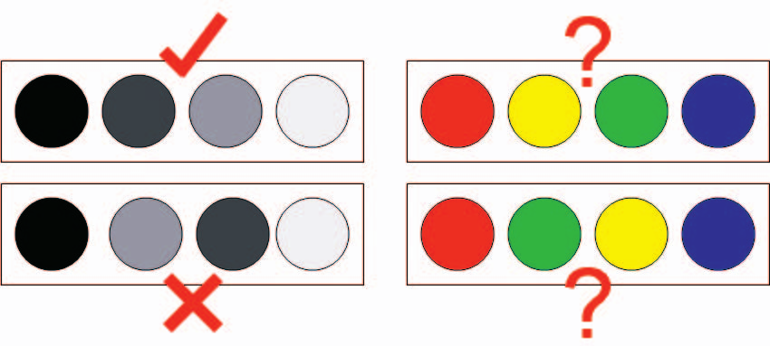
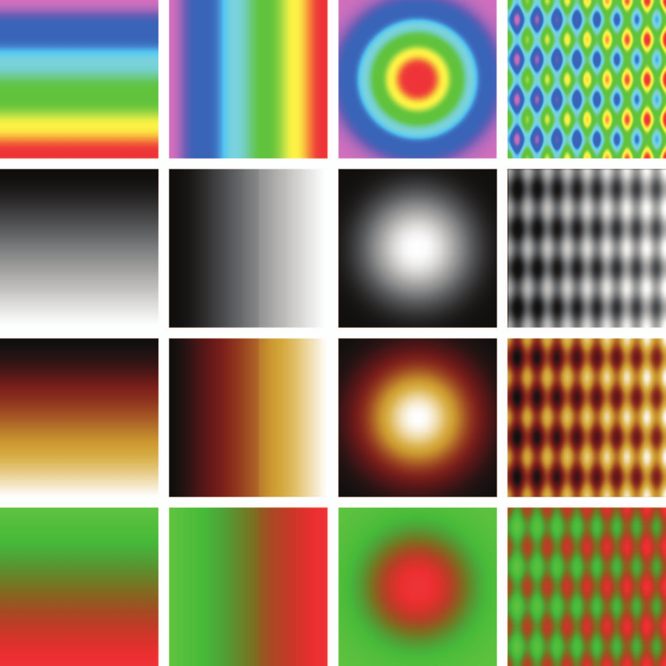
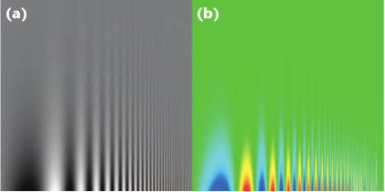
Issues with Rainbow Color Map
Default color map in many visualization systems, but…
1. No intuitive ordering:
3. Artifactual gradients:
2. Can reduce sensivity:
Reference: Borland/Taylor, Rainbow Color Map (Still) Considered Harmful, CG&A 2007
16

Slide 17
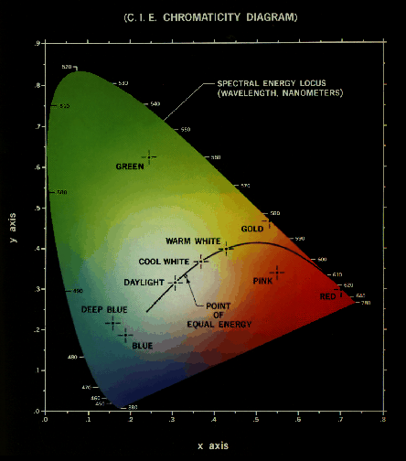
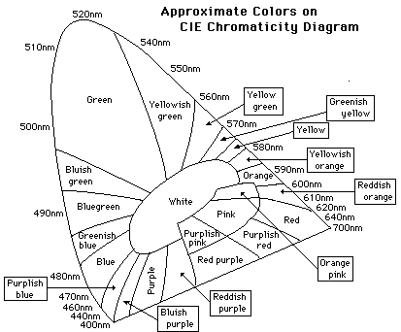
Color Mapping Nominal Data
Around 9 basis colors are reliably distinguished:
Magenta (430 nm)
Blue (476 nm)
Blue-green (504 nm)
Green (515 nm)
Yellow green (556 nm)
Yellow (582 nm)
Orange (596 nm)
Reddish orange (610 nm)
Red (642 nm)
17

Slide 18
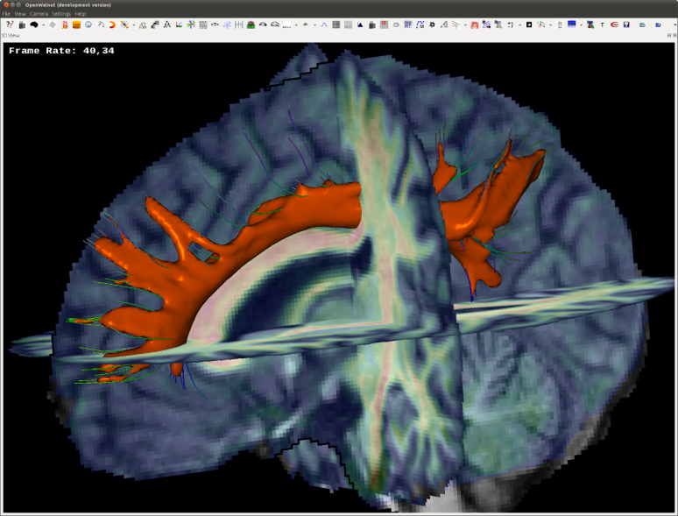
Slicing: Implementation
Basic idea: Render textured slice geometry (e.g., simple quads)
Most convenient to use 3D textures:
If desired, (tri-linear) interpolation is performed by the graphics hardware
For pre-shading, map volume through transfer function and upload RGB texture
For post-shading, upload volume itself and apply transfer function to interpolated value in a fragment shader, e.g., via windowing parameters or a 1D texture lookup
18

Slide 19
Slicing: Two Simple Tricks
If desired, shader programming makes it easy to discard fragments that correspond to air
Index coordinates for the 3D texture lookup can be found from world-space (geometric) coordinates via the inverse of the index-to-world matrix
19

Slide 20
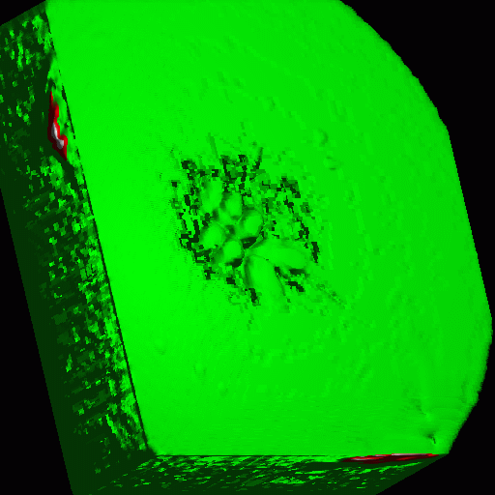
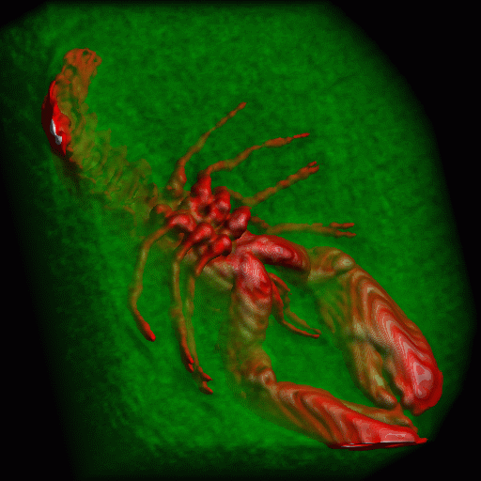
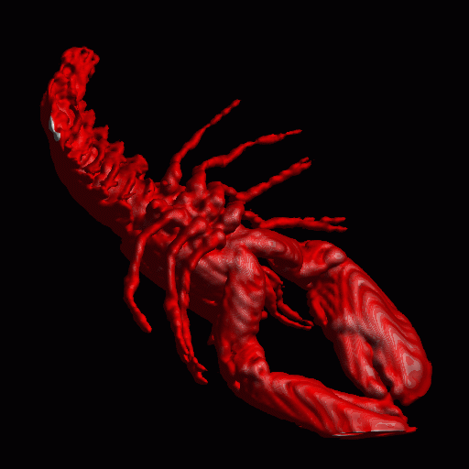
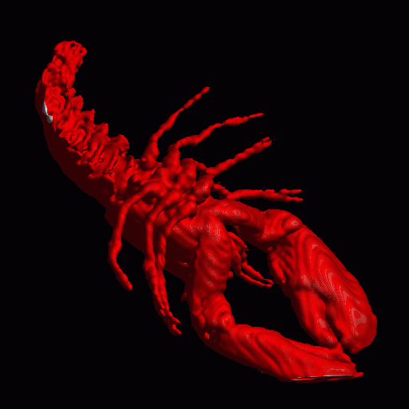
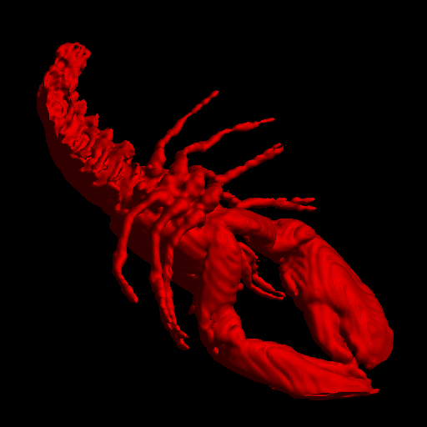

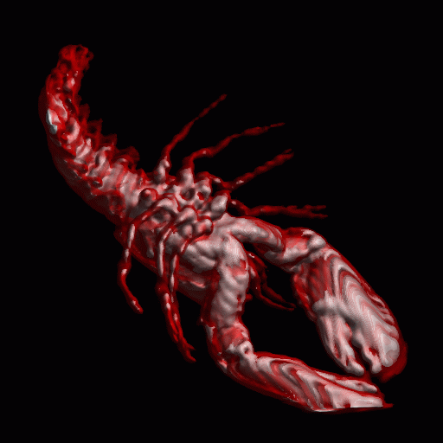
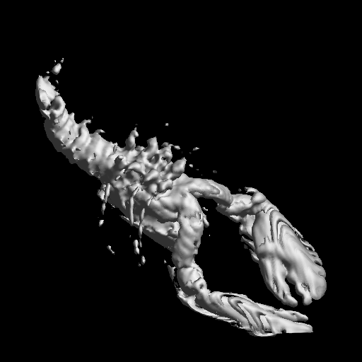
Direct Volume Rendering: Motivation
Same volume with different transfer functions that now include an alpha channel (=opacity) and are rendered volumetrically
20

Slide 21
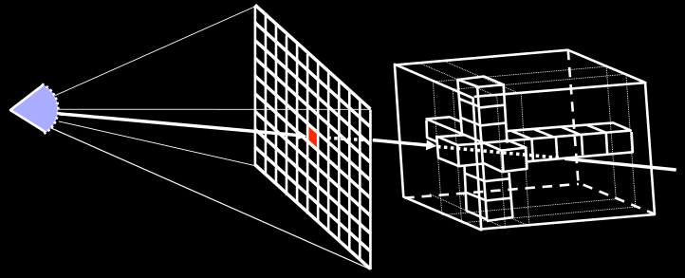
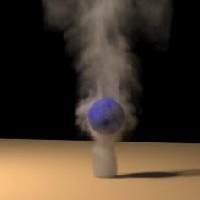
Volume Rendering: Formalization
Optical model: Each point in the volume is considered to emit and absorb light, according to the color and opacity specified by the transfer function. Those contributions are integrated along viewing rays to produce the final image.
21

Slide 22
Optical Models
Emission
active
in-scattering
Absorption
active
out-scattering

Slide 23
Optical Models
Light (Particle) interaction with density volume
Emission only, Absorption only
Emission + Absorption
Scattering + shading/shadowing
Multiple scattering
Notes:
In order to be able to determine output colors for the pixels in the image plane, we need a model that describes the interaction of light with the volume.
For this, the volume is usually considered to consist of a cloud of particles with given densities at different locations in the volume.
We list the most common optical models here, the one most often used in hardware volume rendering being the emission/absorption model, which assigns particles the behavior of emitting and simultaneously absorbing light. More complicated models, e.g., the ones including scattering are by now also possible in hardware rendering, and Joe Kniss presents more on this in his part of the course. But the emission/absorption model basically simply amounts to assigning RGB colors and A opacities to the different scalar values of a volume, which is very simple to use.

Slide 24
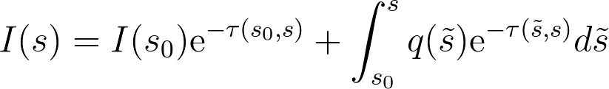
The Volume Rendering Integral
Ray
s₀
s
Light intensity at s
24

Slide 25
The Volume Rendering Integral
Ray
s₀
s
Emission at s₀
Attenuation along s₀-s
25

Slide 26
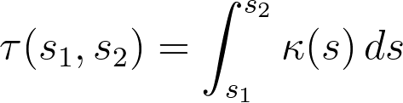
The Volume Rendering Integral
Optical depth τ
Absorption κ
Ray
s₀
s
Initial intensity at s₀
Attenuation along s₀-s
26

Slide 27
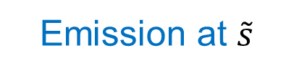
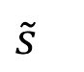

The Volume Rendering Integral
Optical depth τ
Absorption κ
Ray
s₀
$$\tilde{s}$$
s
Emission at $\tilde{s}$
Attenuation along $\tilde{s}$-s
27

Slide 28
The Volume Rendering Integral
Ray
s₀
s
Integrate contributions of all points along the ray
28

Slide 29
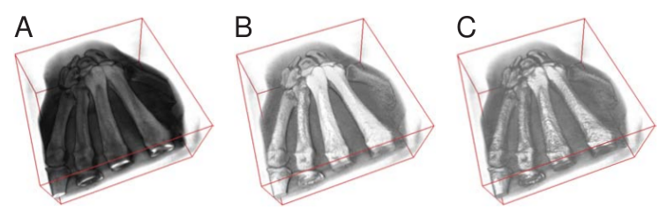
Need for Illumination in Volume Rendering
A: Pure emission + absorption, no illumination
B: Same with diffuse lighting
C: Same with specular lighting
Image Source: Markus Hadwiger and Christof Rezk Salama
29

Slide 30
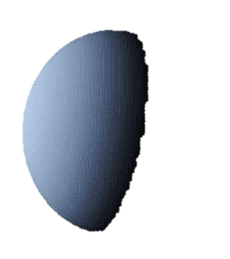
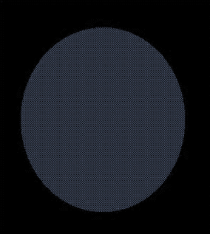
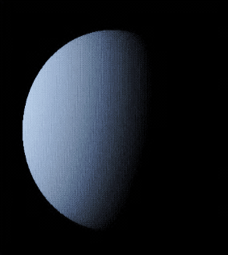
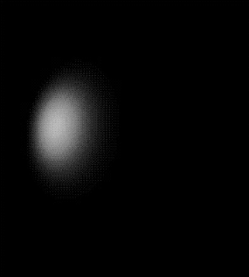
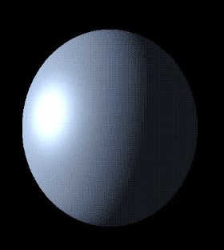
Phong Illumination Model
Surface normal
Ambient light
Diffuse light
Specular light
Light source
N
Perfect reflection
R
L
Eye
E
Ambient
Diffuse
Specular
Phong shaded
30

Slide 31
Ambient / Diffuse Terms in Phong Model
Ambient light: C = k_{a}C_{a}O_{d}
k_{a} is ambient contribution
C_{a} is color of ambient light
O_{d} is diffuse color of object
Diffuse light: C = k_{a}C_{a}O_{d} +k_{d}C_{p}O_{d} cos(θ)
k_{d} is diffuse contribution
C_{p} is color of point light
O_{d} is diffuse color of object
θ is angle of incoming light
Ambient
N
Diffuse
R
L
θ
E
31

Slide 32
Specular Term in Phong Model
Specular light: C = k_{a}C_{a}O_{d} + k_{d}C_{p}O_{d}cos(θ) + k_{s}C_{p}O_{s}cos^{n}(σ)
k_{s} is specular contribution
C_{p} is color of point light
O_{s} is specular color of object
n is exponent of highlight
σ is either - angle between reflected light and eye direction (Phong) or - angle between surface normal and halfway vector (Blinn-Phong)
Specular
32

Slide 33
Specular Models
cos(θ) = R * E (Phong)
cos(σ) = N * H (Blinn-Phong)
N
H
R
L
L + E
E
H =
L + E
33

Slide 34

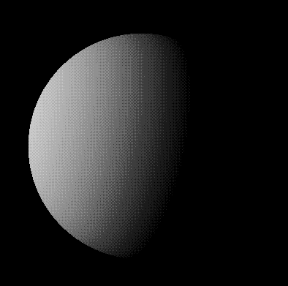

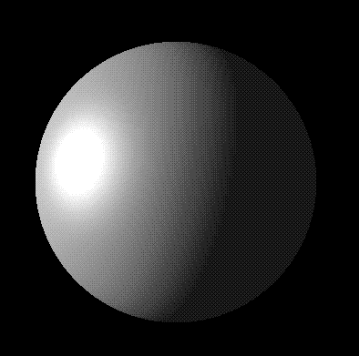
Overall Effect of Phong Shading
Ambient
Diffuse
Specular
K_{a} = 0.1
K_{d} = 0.5
K_{s} = 0.4
Phong shaded
34

Slide 35
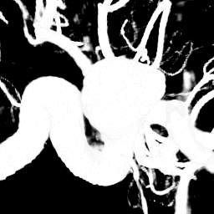
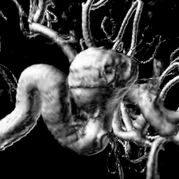
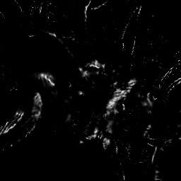
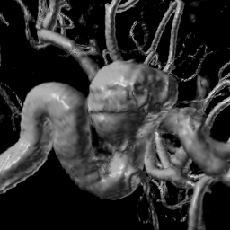
Phong Shading in Direct Volume Rendering
Ambient
Diffuse
Specular
K_{a} = 0.1
K_{d} = 0.5
K_{s} = 0.4
Phong shaded
35

Slide 36
Normal Computation For Shading
What is the normal vector in a scalar field f(x)?
Gradient ∇f(x) is perpendicular to isosurface!
Numerical computation of the gradient:
forward/backward differences
central differences
Sobel Operator
Surface normal
Light source
N
Perfect reflection
R
L
Eye
E
36

Slide 37
Forward/Backward Differences
Convolution kernel: [-1/dx 1/dx] (and analogously)
Forward or backward differences, depending on how stencil is aligned with voxel grid
Very cheap: Only three additional texture lookups in 3D
Detects higher frequencies than central differences
May amplify measurement noise in the data
Not isotropic
37

Slide 38
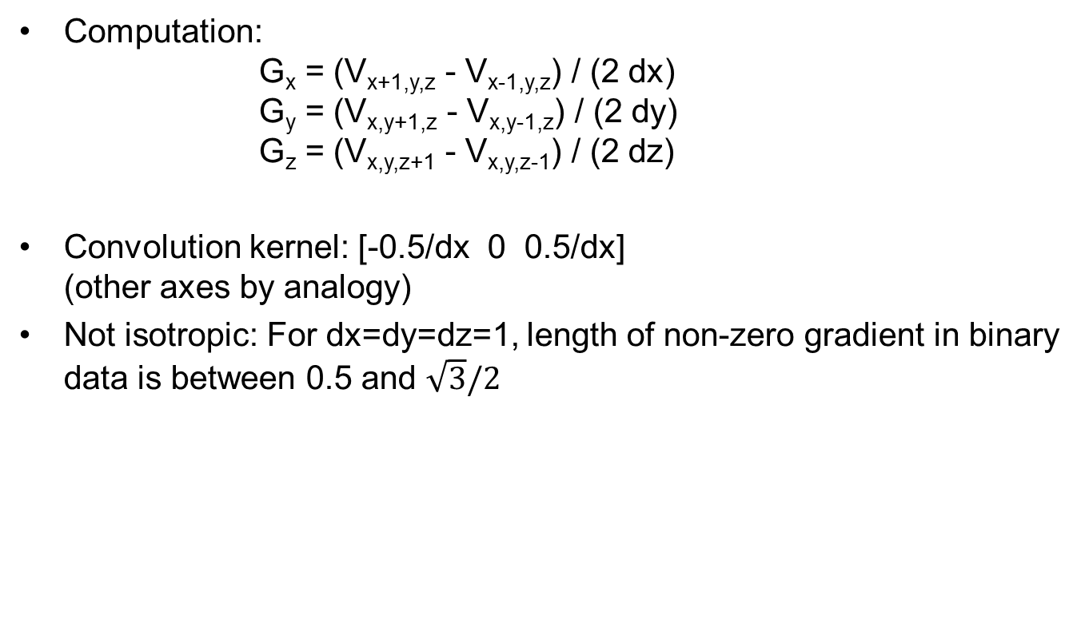
Central Differences (Uniform Grid)
Computation: G_{x} = (V_{x+1,y,z} - V_{x-1,y,z}) / (2 dx) G_{y} = (V_{x,y+1,z} - V_{x,y-1,z}) / (2 dy) G_{z} = (V_{x,y,z+1} - V_{x,y,z-1}) / (2 dz)
Convolution kernel: [-0.5/dx 0 0.5/dx] (other axes by analogy)
Not isotropic: For dx=dy=dz=1, length of non-zero gradient in binary data is between 0.5 and $\sqrt{3}/2$
= 0
= 1
38

Slide 39
Sobel / Prewitt Operators
Based on averaging central differences in a small spatial neighborhood
Smoother estimates of derivatives
More suitable for noisy data
More isotropic
More costly: Requires all values in a 3x3x3 neighborhood and many more multiplications and additions than central or forward/backward differences
Convolution kernel: prev. slice (z₀-1) this slice (z₀) next slice (z₀+1)
-1 0 1 -3 0 3 -1 0 1
-3 0 3 -6 0 6 -3 0 3
-1 0 1 -3 0 3 -1 0 1
39

Slide 40
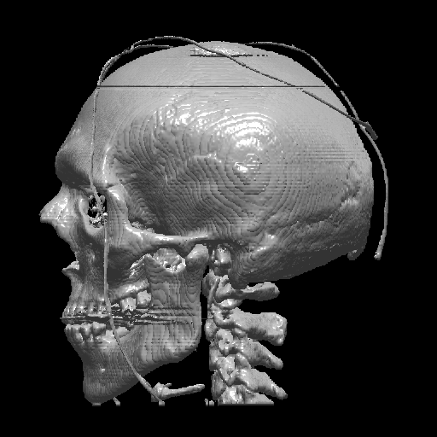
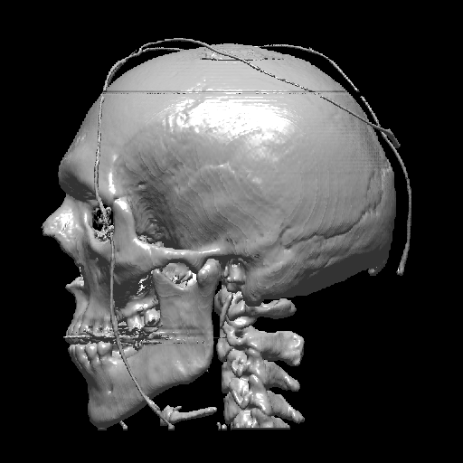
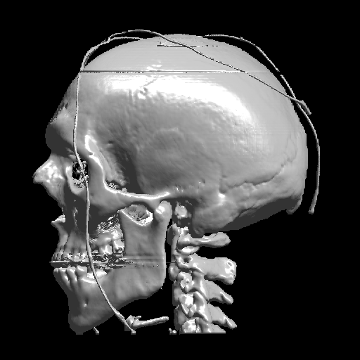
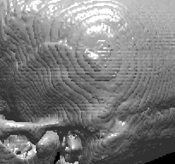
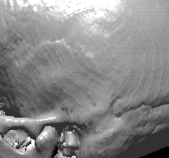

Visual Comparison of Gradient Schemes
Forward/Backward differences
Central differences
Sobel operator
40

Slide 41

Volume Rendering with Clipping Geometry
Parts of the volume can be made transparent by specifying clipping geometry. At its boundary, the surface normal of the clipping geometry, rather than the gradient of the volume, should be used for illumination:
Image Source:
Weiskopf et al., TVCG 2003
41

Slide 42
Computing the Volume Rendering Integral
very important
There is no closed form solution of the integral in general
➔ Approximate the integral with a discrete sum:
Discretization: split ray into segments having constant opacity and emission
Sampling intervals are usually equidistant, but don’t have to be (e.g. importance sampling)
At each sampling location, a sample is reconstructed from the voxel grid by interpolation
42

Slide 43

Associated Colors
Diagram Source: Wittenbrink et al., Opacity-Weighted Color Interpolation for Volume Sampling, IEEE VolVis 1998
43

Slide 44



Absorption vs. Opacity
Optical depth:
Discretize as:
Given opacity A_{j}=1-e^{-κ(j.Δt)Δt} , we can re-write the discretized attenuation
as
This allows us to use Alpha blending.
44

Slide 45


Back-to-Front Compositing
Compute the sum iteratively, starting with C’_{n+1}=0:
C’_{i}=C_{i}+(1-A_{i})C’_{i+1}
Source of Images: Hadwiger et al.
Commonly implemented by rendering view-aligned proxy geometry in back-to-front order:
45

Slide 46
Front-to-back Compositing
Compute the sum iteratively, starting with C’₋₁=A’₋₁=0:
C’_{i}=C’_{i-1}+(1-A’_{i-1})C_{i}
A’_{i}=A’_{i-1}+(1-A’_{i-1})A_{i}
Commonly implemented in a fragment shader.
A’_{i} is monotonously increasing; we can stop computing once A’_{i}≈1 (“early ray termination”)
46

Slide 47
Analogy to Ray Tracing
Similar to ray tracing in surface-based computer graphics
In volume rendering,
we only deal with primary rays; hence: ray-casting
we composit in each step, rather than searching a ray/surface intersection
47

Slide 48

Ray Casting
Shot a ray through every pixel on the screen
Collect color and opacity information along the rays
Numerical approximation of the volume rendering integral
Resample volume at equi-spaced intervals along the ray
Tri-linear interpolation

Slide 49
Ray Casting
How is color and opacity determined at each integration step?
Opacity and (emissive) color in each cell according to classification
Additional color due to external lighting
No shadowing, no secondary effects

Slide 50

Back-to-front strategy
Cout = (1 - α) Cin + αC
C(i)in = C(i-1)out
αout = (1 - α) αin + α
Iterative process. The output color of the previous step becomes the input color of the next step.
Note that the $α$-computation is not necessary for computing the RGB color. It is therefore often omitted.
C(0)in
Cin, αin
C_{i}
αi
C
α
Cout, αout
C(N)out
Notes:
For the iterative computation: C(i)in = C(i-1)out

Slide 51
Front-to-back strategy
Cout = Cin + (1 - αin) αC
αout = αin + (1 - αin) α
C(0)out
Cout , αout
C_{i}
α_{i}
C,
α
Cin, αin
C(N)in
Notes:
Physical model: emissive gas with color C and opacity α

Slide 52

Ray Casting
Composition of the contributions:
F₀
F_{i}
F_{n}
F₀
…
F_{i}
…
F_{n}
…
…
view
view
…
…
a_{n}
a₀
…
a_{i}
…
a_{n}
a₀
a_{i}
Front-to-Back
C = (0,0,0) ; $α$ = 0
FOR i = n .. 0 DO
C = C +$(1−α)$ * a_{i} * F_{i}
$α$ = $α$+$(1−α)$ * a_{i}
END
Back-to-Front
C = (0,0,0)
FOR i = 0 .. n DO
C = (1-a_{i}) * C + a_{i} * F_{i}
END
F₀: color value of the point with maximal distance from viewpoint
F_{n}: color value of the point closest to the viewpoint
a_{i}: opacity values
C: pixel color value

Slide 53

Ray Casting
Composition of the contributions:
F₀
F_{i}
F_{n}
F₀
…
F_{i}
…
F_{n}
…
…
view
view
…
…
t_{n}
t₀
…
t_{i}
…
t_{n}
t₀
t_{i}
Front-to-Back
C = (0,0,0,0) ; $τ$ = 1
FOR i = n .. 0 DO
$τ$ = $τ$ * t_{i}
C = C + $τ$ * F_{i}
END
Back-to-Front
C = (0,0,0,0)
FOR i = 0 .. n DO
C = t_{i} * C + F_{i}
END
F₀: color value of the point with maximal distance from viewpoint
F_{n}: color value of the point closest to the viewpoint
t_{i}: transparency values
C: pixel color value

Slide 54
Illustration of Ray Casting
interpolation kernel
volumetric compositing
color
opacity
1.0
object (color, opacity)
54

Slide 55
Illustration of Ray Casting
interpolation kernel
volumetric compositing
color
opacity
1.0
object (color, opacity)
55

Slide 56
Illustration of Ray Casting
volumetric compositing
color
opacity
1.0
object (color, opacity)
56

Slide 57
Illustration of Ray Casting
volumetric compositing
color
opacity
1.0
object (color, opacity)
57

Slide 58
Illustration of Ray Casting
volumetric compositing
color
opacity
1.0
object (color, opacity)
58

Slide 59
Illustration of Ray Casting
volumetric compositing
color
opacity
1.0
object (color, opacity)
59

Slide 60
Illustration of Ray Casting
volumetric compositing
color
opacity
object (color, opacity)
60

Slide 61


Volume Rendering Examples

Slide 62
Illustration of Texture-Based Rendering
Slice-based rendering
color
opacity
object (color, opacity)
Similar to ray casting with simultaneous rays
62
Notes:
Bild: Ruediger Westermann, Vorlesungsskript

Slide 63






2D vs. 3D Texture-Based Rendering
2D textures axis-aligned
texturing
(bilinear interpolation)
compositing
(blending)
3D texture view-aligned
texturing
(trilinear interpolation)
compositing
(blending)
Image Source: Klaus Engel
63
Notes:
Bilder: Klaus Engel

Slide 64



Drawback of 2D Texture-Based Rendering
Artifacts when stack is viewed close to 45 degrees
On modern (non-mobile) GPUs, 3D textures are the norm and are most commonly used.
64
Notes:
Bilder: Daniel Weiskopf

Slide 65


Ray Casting vs. View-aligned slicing
Ray Casting
View-Aligned Slicing

Slide 66
Other Compositing Schemes
very important
Intensity
Maximum
Accumulate
Average
First Hit
Depth
66

Slide 67


Accumulate: Standard Volume Rendering
Intensity
Accumulate
Depth
67

Slide 68


First Hit: Renders an Isosurface
Intensity
First Hit
Depth
68

Slide 69


Averaging: Produces X-ray(-like) images
Intensity
Average
Depth
69

Slide 70

Maximum Intensity Projection (MIP)
Intensity
Maximum
Often used to extract vessel structures in magnetic resonance angiograms
Image Source: Thomas Fogal
Depth
70

Slide 71

Maximum Intensity Projection (MIP) Example

Slide 72

Increase Stepsize during Interaction
Increasing stepsize in ray casting, or reducing the number of slices reduces the computational effort, but can lead to artifacts in the visualization.
Common trick: Increase stepsize to allow for a more fluent interaction (e.g., changing the viewpoint), produce a high-quality still image afterwards.
Image Source: Hadwiger and Rezk Salama, 2004
72

Slide 73
Early Ray Termination
Problem: ray casting can be time consuming
Idea:
Neglect „irrelevant“ information to accelerate the rendering process
Exploit coherence
Early-ray termination
Idea: colors from distant regions do not contribute if accumulated opacity is too high
Stop traversal if contribution of sample becomes irrelevant
Front-to-back compositing
73

Slide 74
Empty Space Skipping
Space leaping
Skip empty cells
Or: Homogenety acceleration
Approximate homogeneous regions with fewer sample points
Approaches:
Hierarchical spatial data structure
Bounding boxes around objects
Proximity clouds
…
74

Slide 75

Octrees/PARC for Empty Space Skipping
Hierarchical spatial data structure
Octree
Empty octree cells are not subdivided further and can be skipped quickly during traversal (see figure)
Extendable to Homogeneity-acceleration: Store mean value and variance in nodes of octree
Bounding boxes around objects
Polygon assisted ray casting (PARC)
75
Notes:
Bild aus: R. Yagel, Z. Shi; Accelerating Volume Animation by Space-Leaping (1993)

Slide 76

Adaptive Screen Sampling
Approach by [Levoy 1990]
Rays are emitted from a subset of pixels (on image plane)
Missing values are interpolated
In areas of high value gradient additional rays are traced
76

Slide 77
Shear-Warp Factorization: Idea
Popularized for volume rendering by [Lacroute & Levoy 1994]
General goal: make viewing rays parallel to each other and perpendicular to the image
This is achieved by a simple shear
shear
warp
Sketch assumes orthographic projection, but generalizations for perspective projections exist.
77

Slide 78

Shear-Warp Factorization: Illustration
Shear along the volume slices (3D)
Projection and compositing to get intermediate image (3D -> 2D)
Warping transformation of intermediate image to get correct result (2D)
78
Notes:
Scan lines in intermediate image are parallel to scan lines in sheared volume data

Slide 79



Examples of Different Transfer Functions
79

Slide 80




Basic Transfer Function Editing
80

Slide 81


Transfer Functions Re-Examined
We introduced a transfer function as a map of data values to colors:
More precisely, that transfer function should be seen as the composition of two functions:
Map data value to probabilities of the presence of any of n materials at this point:
Map the probabilities to a color value by assigning a color C_{i} to each material:
81

Slide 82
Gradient-based Classification
In many cases, rapid changes in data values are important features
Boundaries between different objects
Indicated by a large gradient magnitude
Isosurface “strength”
May want to assign a high value of opacity in regions of change
82

Slide 83
Gradient in Isosurface Rendering
Levoy [1988] suggests to combine scalar value and gradient of the scalar field in a transfer function to render isosurfaces: 2d transfer function.
Gradient magnitude
|
|
|
∇f
Opacity
α
(
x
i
)|
Opacity
α
v
f
v
Acquired value
f
(
x
i
)
83

Slide 84




2D Transfer Functions
2D histogram (x: value, y:gradient magnitude)
Material boundaries correspond to arcs
d
f
c
|∇f |
b
|∇f |
e
Materials:
A: air
B: soft tissue
C: bone
Material boundaries:
D: air – soft tissue
E: soft tissue – bone
F: air – bone
Visualization using 2D transfer function
From Hansen, Johnson: The Visualization Handbook
84

Slide 85
Multi-Dimensional Transfer Functions
In many cases, scalar value alone is not enough to reliably identify boundary regions/surfaces
Approach by [Kindlmann & Durkin 98; Kniss, Kindlmann, Hansen 01]:
3D transfer functions, depending on
Scalar value
Magnitude of the gradient
Second derivative along the gradient direction
85

Slide 86

Derivatives at Boundaries
86

Slide 87



3D Transfer Functions
|∇f |
|∇f |
Material boundaries:
E: dentin – pulp
F: background – dentin
G: dentin – enamel
H: background – enamel
Only using a 3D transfer function, F and G can be separated clearly from other material boundaries like E and H.
From Hansen, Johnson: The Visualization Handbook
87

Slide 88


Specification of 3D Transfer Functions
Primarily based on 2D Histogram (that is overlaid onto transfer function)
Dependence on second derivative:
Maximum opacity where second derivative is 0
Otherwise decreasing opacity (amount of decrease can be controlled by user)
second derivative emphasis
gradient magnitude
|∇f |
boundary surface
scalar value
88

Slide 89

Example: Extraction of two boundaries
“Triangular classification” function in histogram:
Upper and lower threshold for gradient magnitude
Maximum opacity along center line
Opacity falling off towards left and right edges of triangle
89

Slide 90
Cluster-based TF Specification
Problem: In high dimension, interactive specification of transfer function becomes more challenging Approach by [Tzeng & Ma 04]:
Cluster Voxels in Feature Space
Assign Material Properties per Cluster
Interactive Splitting and Merging of Clusters
90

Slide 91


Examples of Cluster-based TF Specification
Correspondence Cluster - Material
Interactive Cluster Splitting
91

Slide 92

Learning-based TF Specification
Problem: In high dimension, interactive specification of transfer function becomes more challenging Approach by [Tzeng et al. 05]:
User scribbles on a Slice Visualization
Examples of foreground/background voxels
Train a Classifier / Transfer Function
Neural Network
Support Vector Machine
Generalizes to high dimension (e.g., 10D)
1D TF
2D TF
10D TF
92

Slide 93

Iterative Refinement in Learning Approach
1st Sketch
2nd Sketch
Final Sketch
93

Slide 94
Pre-Segmentation
Problem: Some structures are impossible to distinguish even with high-dimensional transfer functions
Example CT: different organs have similar X-ray absorption
Approach: In pre-segmentation, assignment of voxels to classes (i.e., the first step of the transfer function) is done by a specialized, (semi-) automated segmentation algorithm before visualizing the data
Can better account for spatial continuity
Can account for prior knowledge
%
tissue
air
fat
bone
CT number
94

Slide 95

Example Pre-Segmentation
Anatomic atlas
95

Slide 96
Splatting: Basic Idea
Introduced to volume rendering by [Westover 1990]
Basic Idea: project each sample onto the image plane
Object-order method
96

Slide 97
Splatting: Mathematical Formulation
Original model: Reconstruct a continuous volume using the (spherically symmetric) interpolation kernel w :
Analytic integral along a ray r for intensity (emission):
After exchanging summation / integration:
splatting kernel (= “splat”)
97

Slide 98
2D Splat from 3D Kernel
The 3D rotationally symmetric filter kernel is integrated to produce a 2D filter kernel
3D filter kernel
Integrate along one dimension
2D filter kernel
98

Slide 99

Splats as Voxel “Footprints”
The splatted (integrated) kernel can be seen as the “footprint” of a voxel on the image plane
Splat spreads the voxel contribution across multiple pixels
Extent of the 3D kernel h(x,y,z) approximated by a sphere
99

Slide 100
Footprint Pre-Integration
Larger footprint increases blurring and used for high pixel-to-voxel ratio
Footprint geometry
Orthographic projection: footprint is independent of the view point
Perspective projection: footprint is elliptical
Pre-integration of footprint
For perspective projection: additional computation of the orientation of the ellipse
100

Slide 101
Splatting: Algorithm
Volume
Represented by voxels
Slicing
Image plane:
Sheet buffer
Compositing buffer
volume slices
sheet buffer
image plane
compositing buffer
101

Slide 102
Splatting: Algorithm
Add voxel kernels within first sheet
volume slices
sheet buffer
image plane
compositing buffer
102

Slide 103
Splatting: Algorithm
Transfer to compositing buffer
volume slices
sheet buffer
image plane
compositing buffer
103

Slide 104
Splatting: Algorithm
Add voxel kernels within second sheet
volume slices
sheet buffer
image plane
compositing buffer
104

Slide 105
Splatting: Algorithm
Composite sheet with compositing buffer
volume slices
sheet buffer
image plane
compositing buffer
105

Slide 106
Splatting: Algorithm
Add voxel kernels within third sheet
volume slices
sheet buffer
image plane
compositing buffer
106

Slide 107
Splatting: Algorithm
Composite sheet with compositing buffer
volume slices
sheet buffer
image plane
compositing buffer
107

Slide 108
Splatting: Overlapping Kernels
Inaccurate compositing when splats overlap
Incorrect mixture of
Integration (3D kernel to 2D splat) and
Compositing
problematic
108

Slide 109

Splatting: Advantages and Disadvantages
Splatting in SPH (Smooth Particle Hydrodynamics)
Advantages:
Quite fast
Easy to accelerate further: only relevant voxels must be projected
After sorting, it is possible to splat even scattered data
Disadvantages:
Blurry images for zoomed views
High fill-rate for zoomed splats
Dilemma when splats overlap
109

Slide 110
Direct Volume Rendering
Summary
Optical Volume Rendering Model
Volume Rendering Integral
Illumination
Direct Volume Rendering
Ray Casting
Composition Schemes
Transfer Functions

